Slide 1
People tech group
Vishal Kadam

Slide 2
Contents
Variables
Data types
Operators

Slide 3
Variables
Variables is name given to a memory location. It is used to store data.
Values of that particular variable can be changes and reused many times.
Variable must be declared before use.
Ex.
Data type
int empid = 1794;
Value
Variable Name

Slide 4
Rules for Declaring Variables
The name of the variable contains letters, digits, and underscores and they are case sensitive.
Name of variable must not contain white space and special character.
Variable name must start with some letter or underscore.
We can not use some keywords which are already present in C++.

Slide 5
Data types
Data type is nothing but which defines which type of data and how much memory it can hold.
C++ supports the following data type:
Primitive data type
(Ex. int, float, char, double, boolean, void)
Derived data type
(Ex. Array Function, pointer)
User-Defined data type
(Ex. Structure, Union, Enum)

Slide 6
Examples of data types
Primitive data types:-
int empid = 1794; (Size:- 4 bytes)
char gender = ‘M’; (Size:- 1 byte)
float value = 23.49; (Size:- 4 bytes)
double salary = 5000.0; (Size:- 8 bytes)
bool isactive = true; (Size:- 1 byte)
long count = 95000000; (Size:- 4 bytes)

Slide 7
Operators in c++
Operators are classified into 6 types:
Arithmetic operators
Relational operators
Logical operators
Bitwise operators
Assignment operators
Ternary operators
Operator | Type
++ , -- | Unary operator
+ , - , * , / , % | Arithmetic operator
< , <= , > , >= , == , != | Relational operator
&& , || , ! | Logical operator
&, | , << , >> , ~ , ^ | Bitwise operator
= , += , -= , *= , /= , %= | Assignment operator
?: | Ternary operator

Slide 8
Examples of operators:
Arithmetic operators:- (must required two operands)
#include <iostream>
Using namespace std;
int main()
{
int a = 7;
int b = 4;
cout << "Addition: " << (a + b); // Addition (+)
cout << "Subtraction: " << (a - b); // Subtraction (-)
cout << "Multiplication: " << (a * b); // Multiplication (*)
cout << "Division: " << (a / b); // Division (/)
cout << "Modulus: " << (a % b);// Modulus (%)
}

Slide 9
Examples of operators:
Relational operators:- (gives o/p as a Boolean value)
#include <iostream>
Using namespace std;
int main()
{
int x = 10;
int y = 20;
cout << (x == y); // Equal to (==)
cout << (x != y); // Not equal to (!=)
cout << (x > y); // Greater than (>)
cout << (x < y); // Less than (<)
cout << (x >= y); // Greater than or equal to (>=)
cout << (x <= y); // Less than or equal to (<=)
}

Slide 10
Examples of operators:
Logical operators:- (gives o/p as a Boolean value)
#include <iostream>
Using namespace std;
int main()
{
bool a = true;
bool b = false;
cout << (a && b); // Logical AND (&&)
cout << (a || b); // Logical OR (||)
cout << (!a); // Logical NOT (!)
}

Slide 11
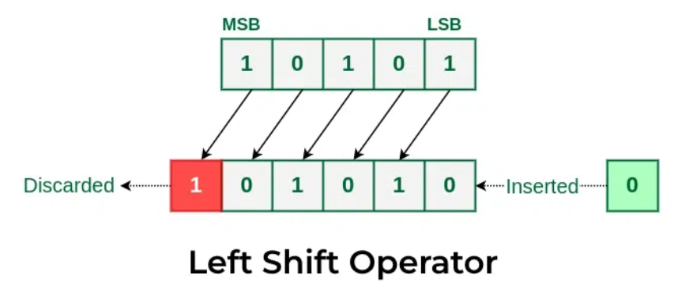
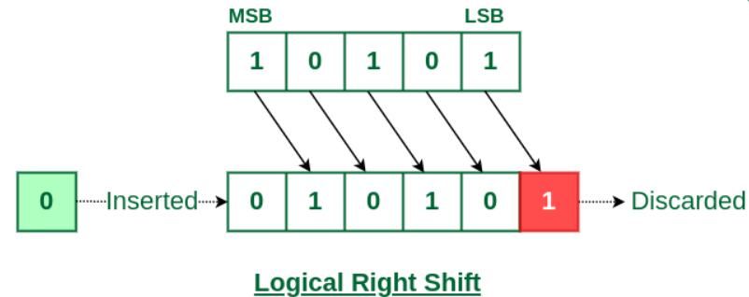
Examples of operators:
Bitwise operator:- (Perform operations on bit)
#include <iostream>
Using namespace std;
int main()
{
int a = 7; //compiler convert this into binary code to perform operations
int b = 4; //compiler convert this into binary code to perform operations
cout << "Bitwise AND: " << (a & b); // Bitwise AND (&)
cout << "Bitwise OR: " << (a | b); // Bitwise OR (|)
cout << "Bitwise XOR: " << (a ^ b); // Bitwise XOR (^)
cout << "Left Shift: " << (a << 1); // Left shift (<<)
cout << "Right Shift: " << (a >> 1); // Right shift (>>)
}

Slide 12
Examples of operators:
Assignment operator:- (Assign the value to particular variable)
#include <iostream>
Using namespace std;
int main()
{
int x = 7;
x += 4; // x = x + 4
cout << "x += 5: " << x;
x -= 3; // x = x - 3
cout << "x -= 3: " << x;
x *= 2; // x = x * 2
cout << "x *= 2: " << x;
x /= 4; // x = x / 4
cout << "x /= 4: " << x;
x %= 3; // x = x % 3
cout << "x %= 3: " << x;
}

Slide 13
Examples of operators:
Ternary opeartor:- (Also called as conditional operator)
#include <iostream>
Using namespace std;
int main()
{
int a = 7;
int b = 4;
string result = (a > b) ? "a is greater" : "b is greater";
cout << result; // Ternary operator (? :)
}

Slide 14
Examples of operators:
Unary operator:- (Required only one operand)
#include <iostream>
Using namespace std;
int main()
{
int x = 7;
cout << "Pre-increment: " << ++x; // Pre-increment (++x)
cout << "Post-increment: " << x++; // Post-increment (x++)
cout << "Value of x after post-increment: " << x;
cout << "Pre-decrement: " << --x; // Pre-decrement (--x)
cout << "Post-decrement: " << x--; // Post-decrement (x--)
cout << "Value of x after post-decrement: " << x;
}

Slide 15
Thank you

